Slide 1

Star Mission
ITMD 455 Final Project

Slide 2
THE TEAM!
Deborah Barndt
Craig Finnern
Gabriel Torres

Slide 3
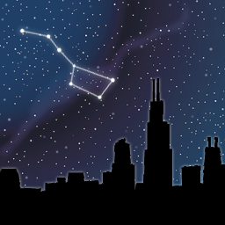
THE IDEA
We wanted to help students learn more about astronomy, and explore the outside world through a fun and engaging app in order to get them more interested in STEM.

Slide 4

HOW WE DID IT
Divide and Conquer!
Three coders working separately and meshing code in the end.

Slide 5
“That’s so cool! I want to play with it!
Can I have it?! ”
6th grade student at IPRO Day

Slide 6
FUTURE FEATURES
Movement guided star map to use GPS and camera.
Refreshing “Events” or “Space News” tab
Ability to share information to family and friends
Multiple difficulties for quizzes with high scores
More videos and links to other sites
Adding an educator version for teachers
Expanding for other age groups

Slide 7
“Houston, we have a problem”
Keeping a consistent theme
Making the app easy to use
Keeping the content kid friendly
Designing the app to be fun but educational
Combining all the code together
Different API versions

Slide 8
THE APP!

Slide 9
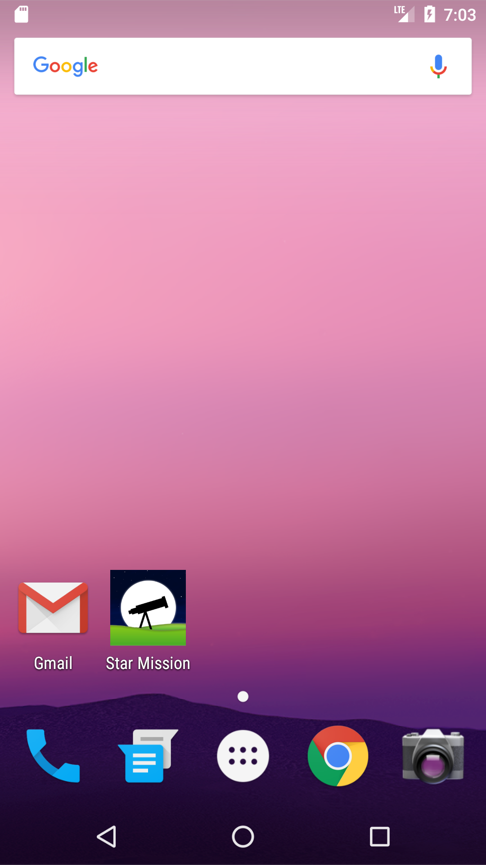
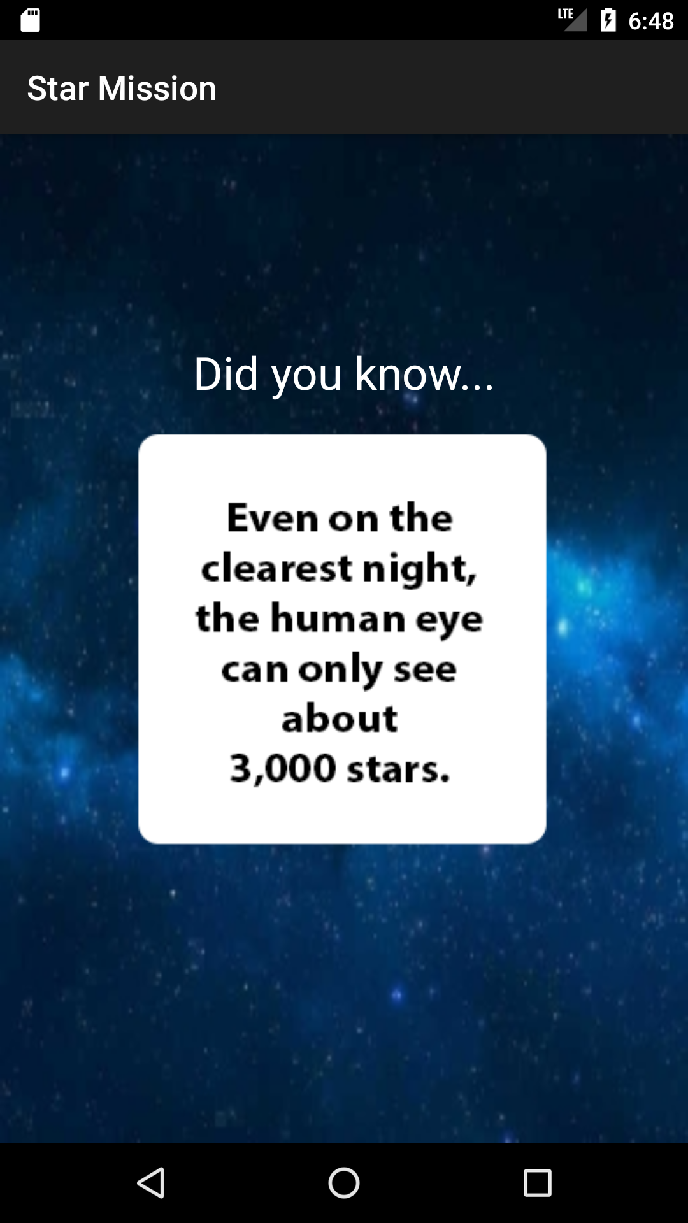

Slide 10
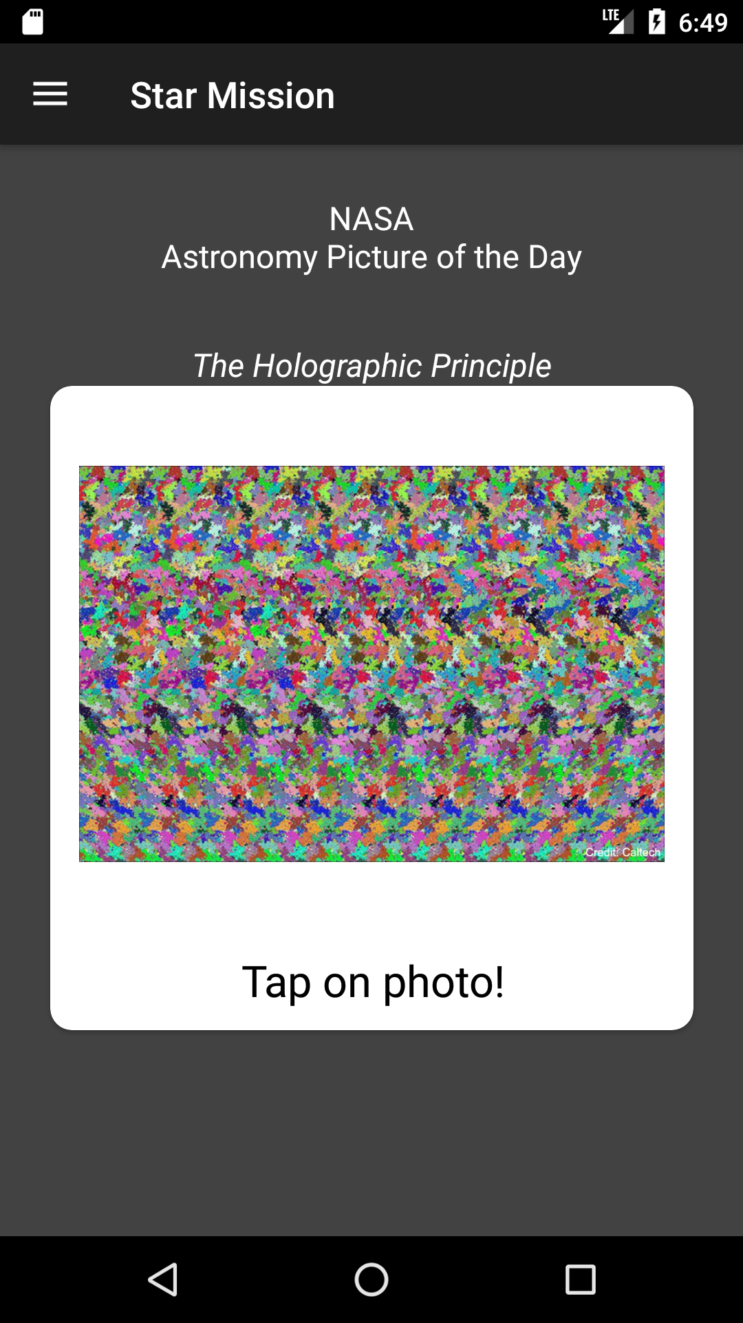
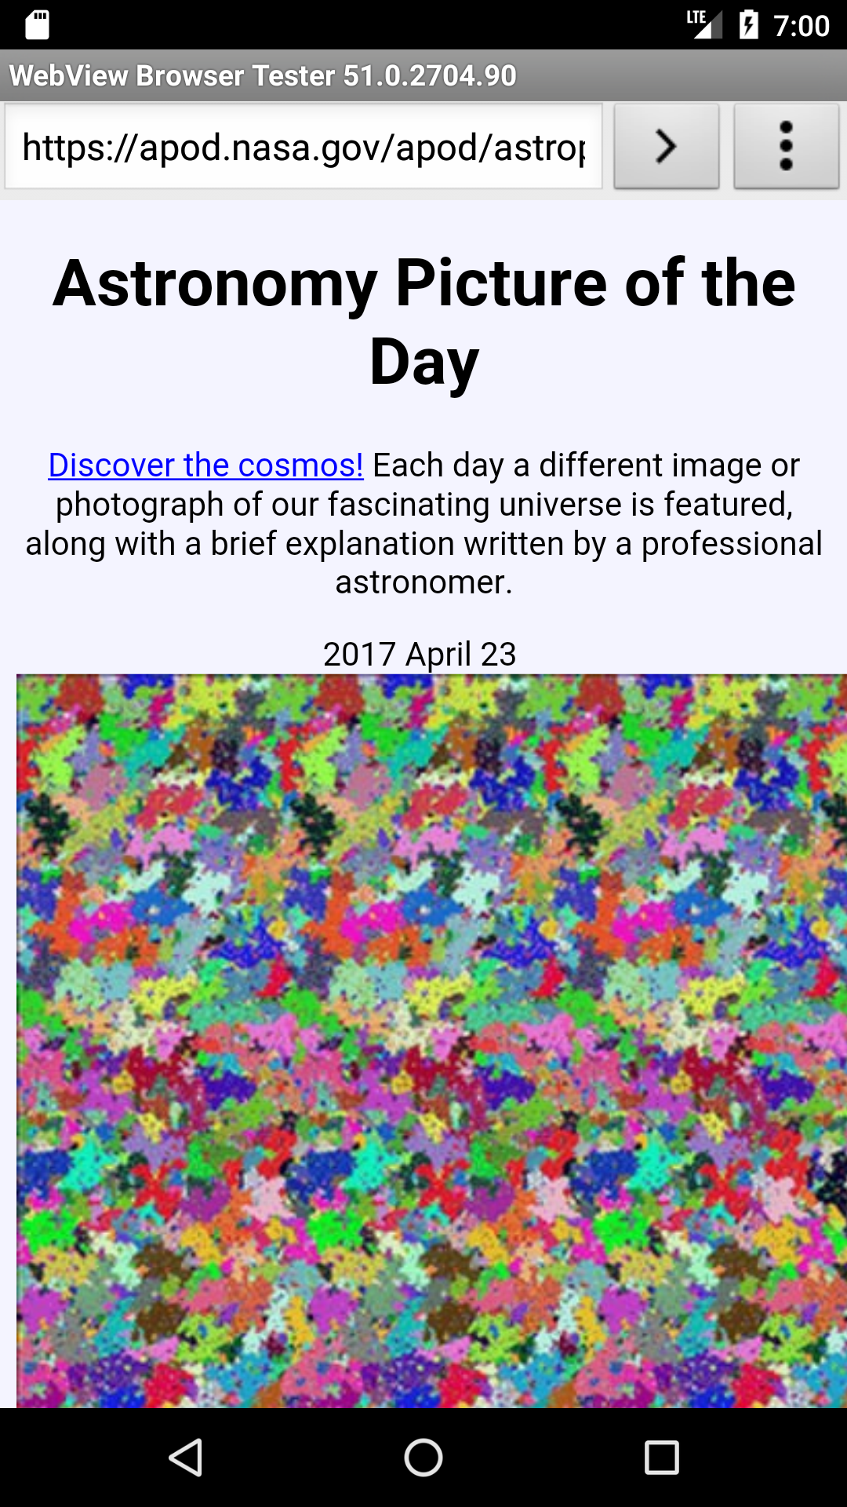

Slide 11
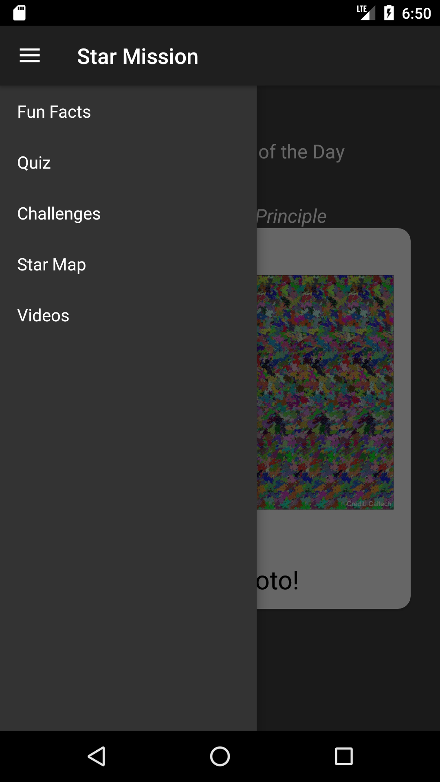

Slide 12
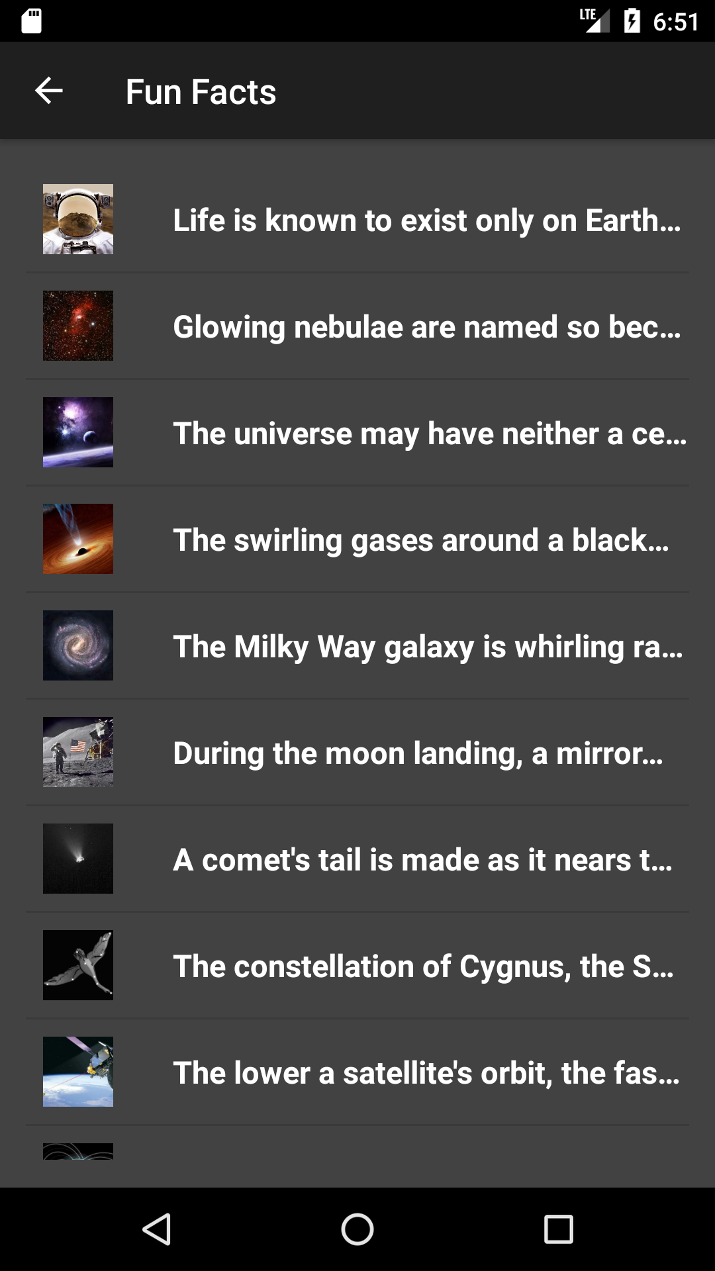
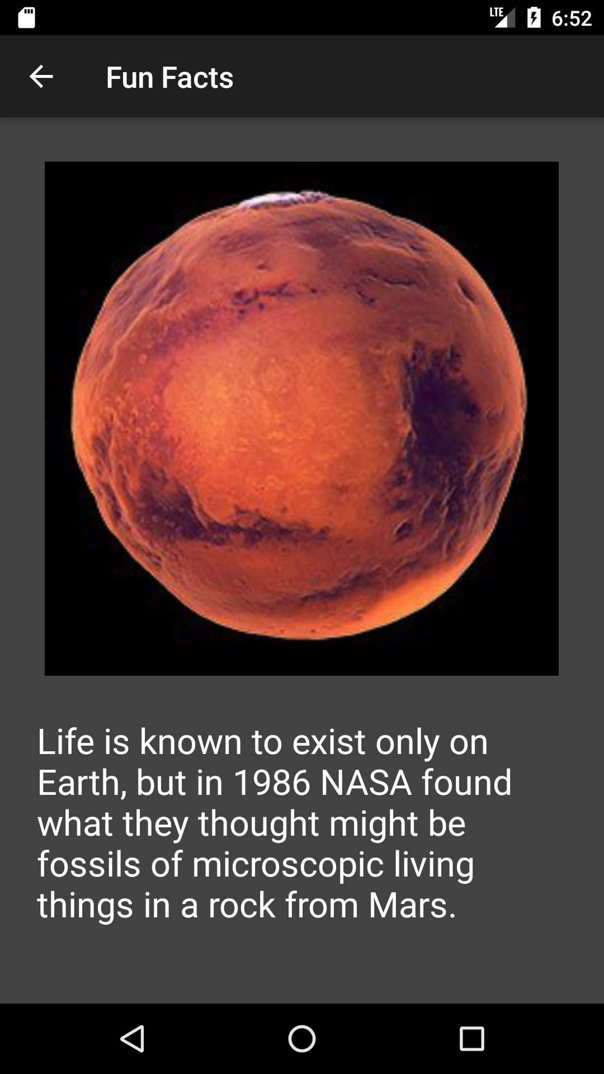

Slide 13
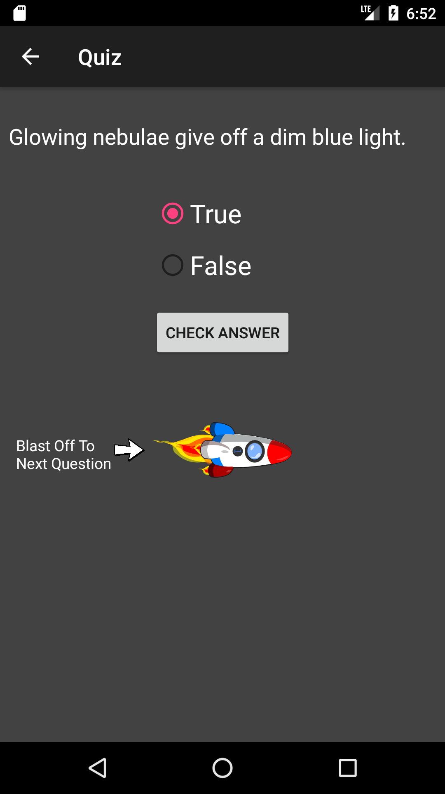
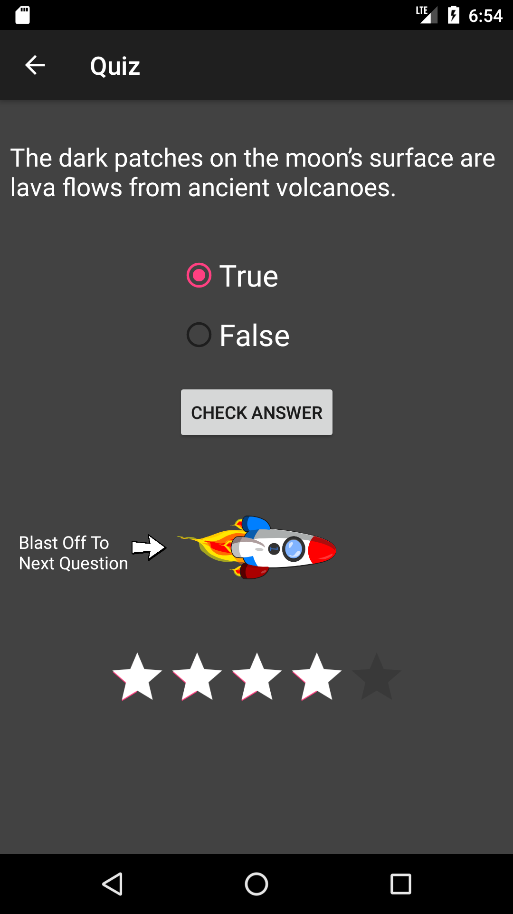

Slide 14
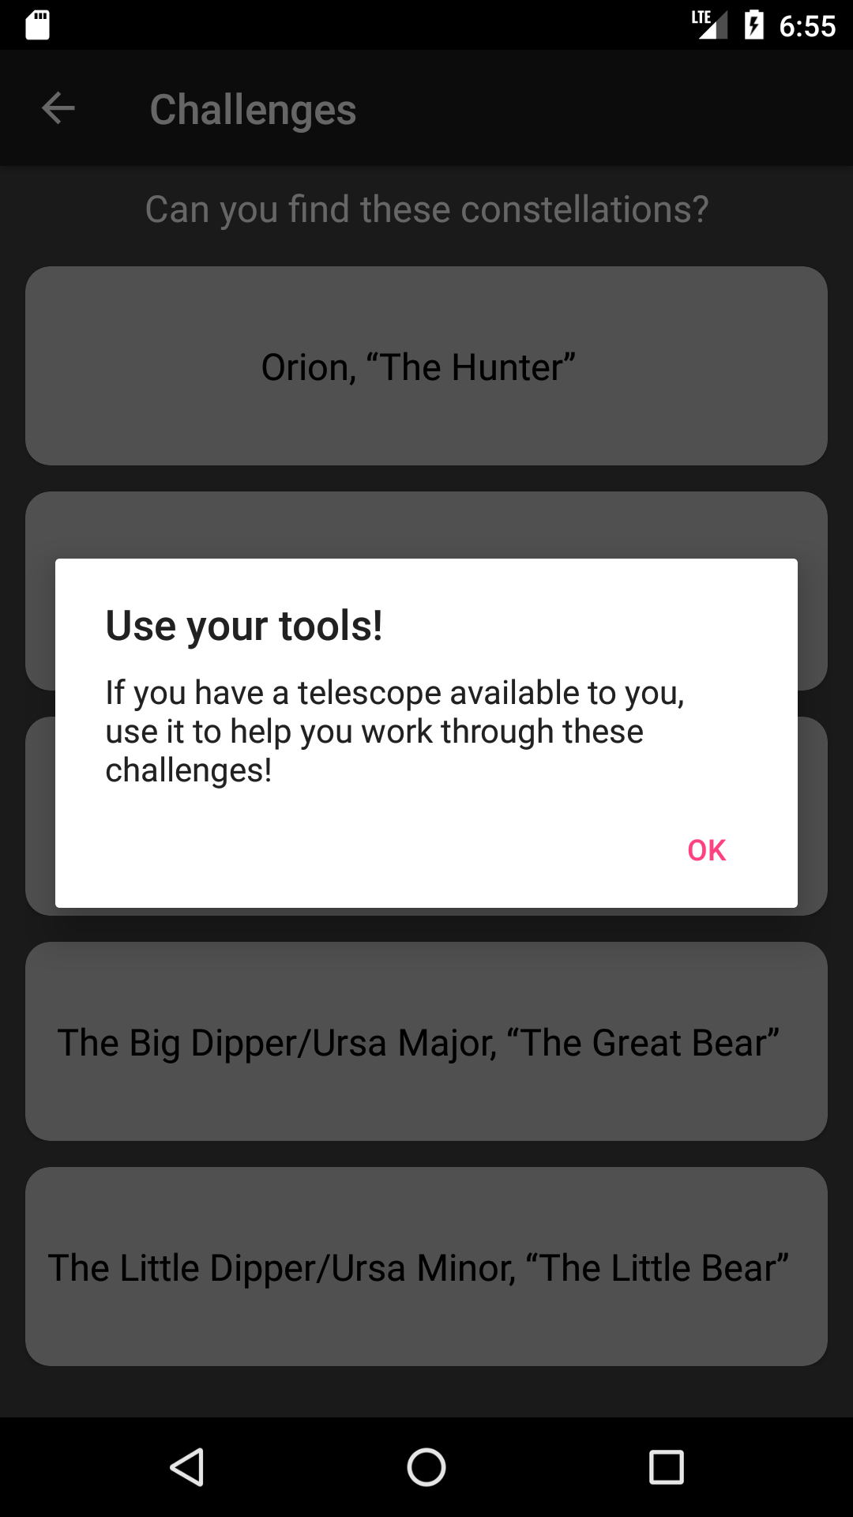
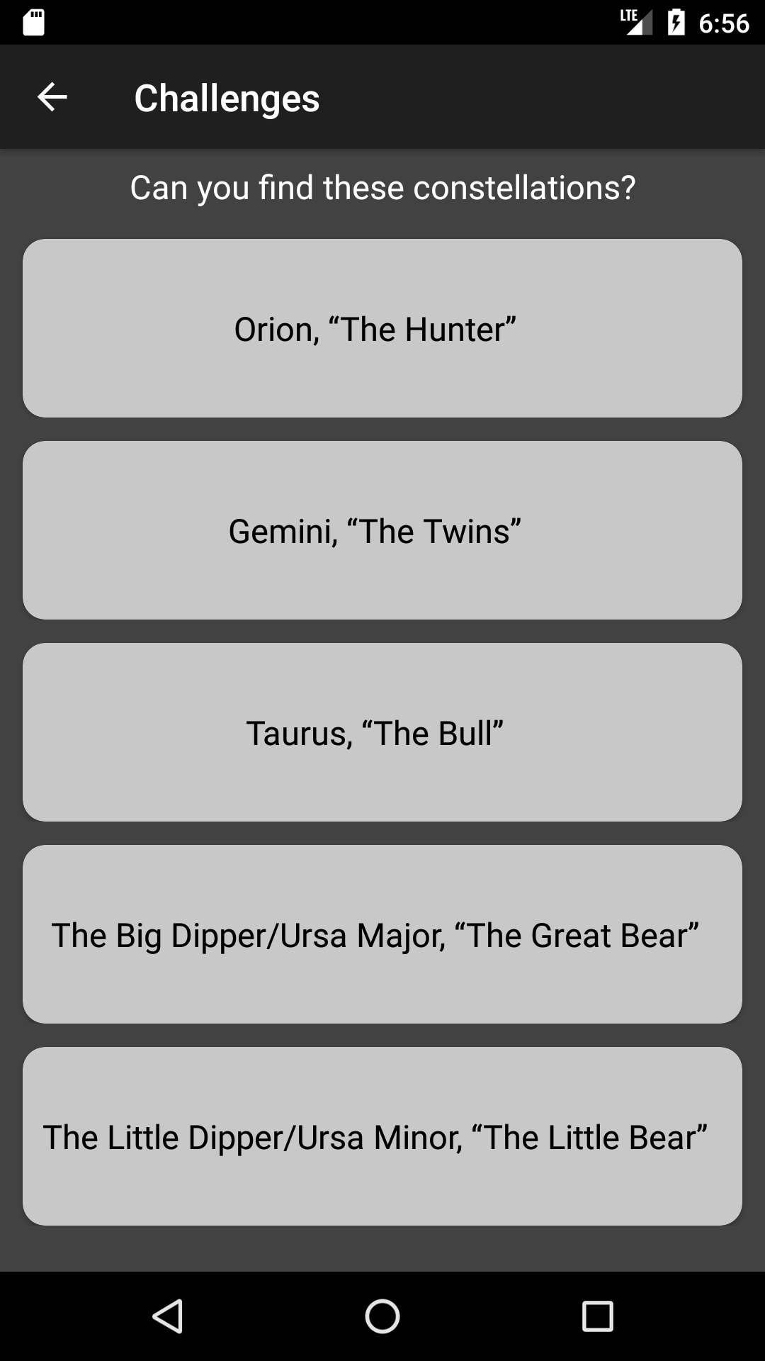

Slide 15
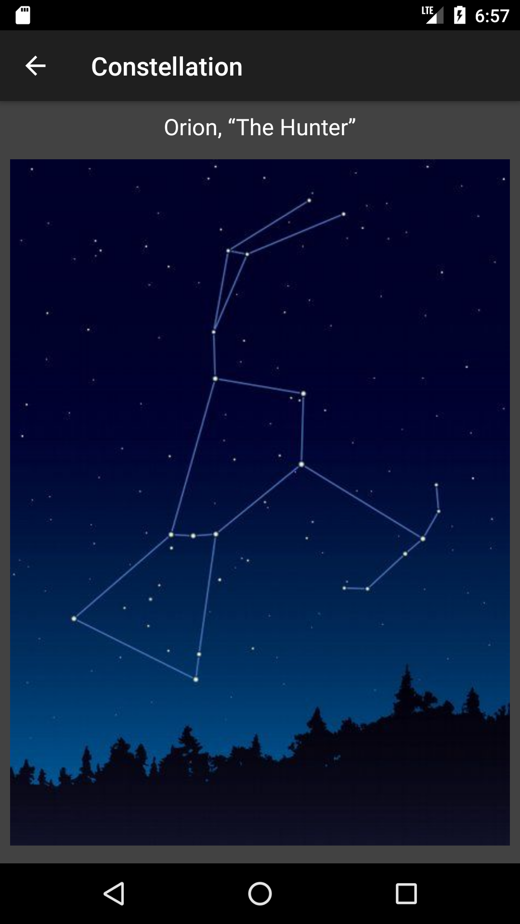

Slide 16
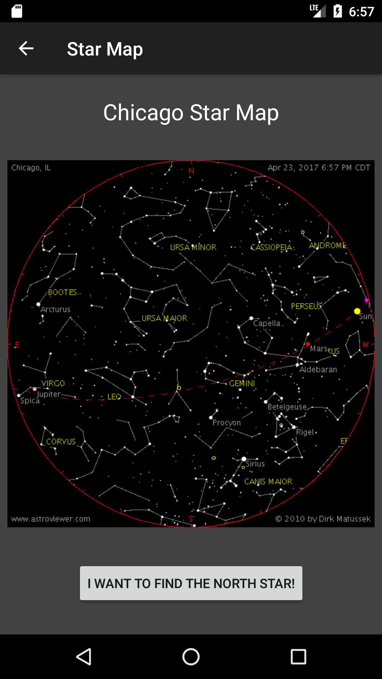
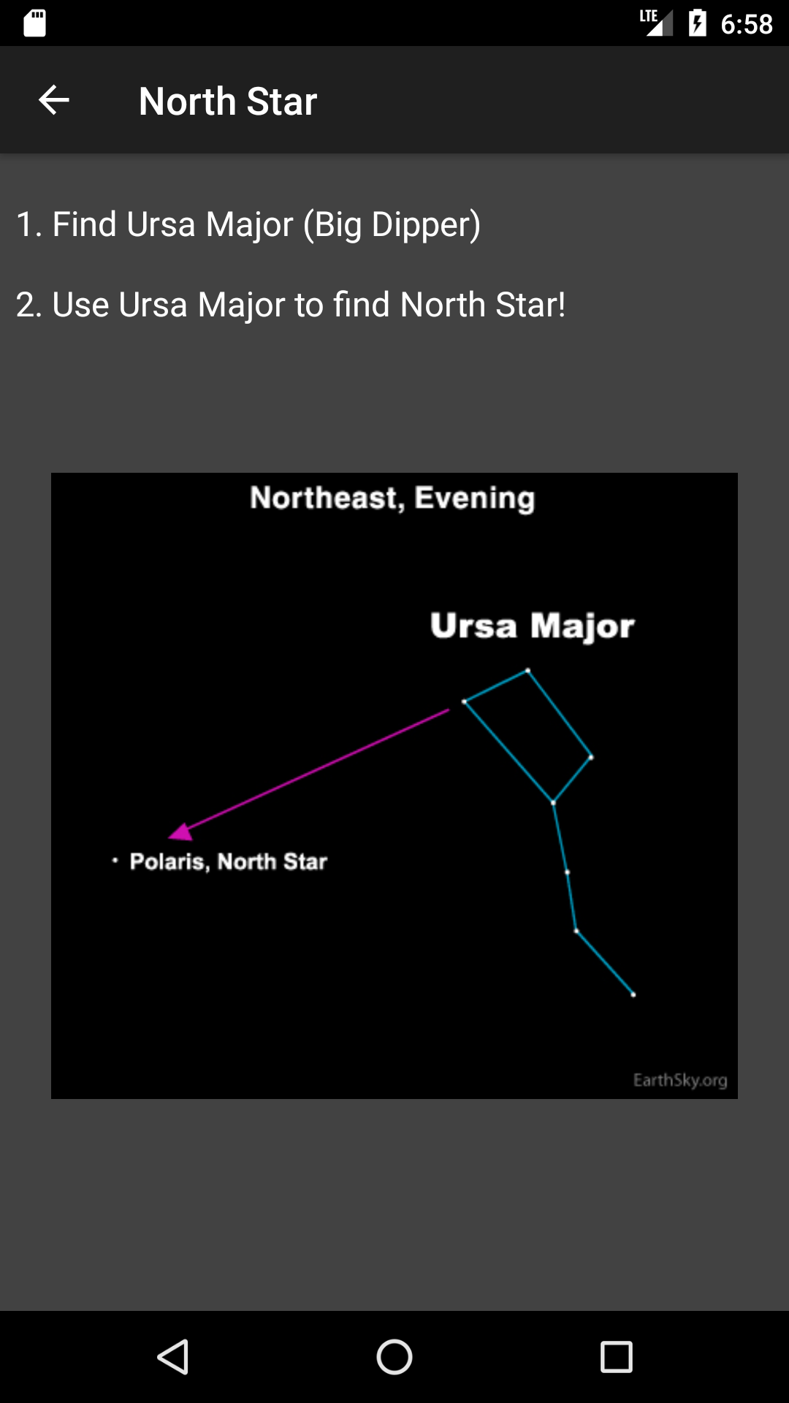

Slide 17
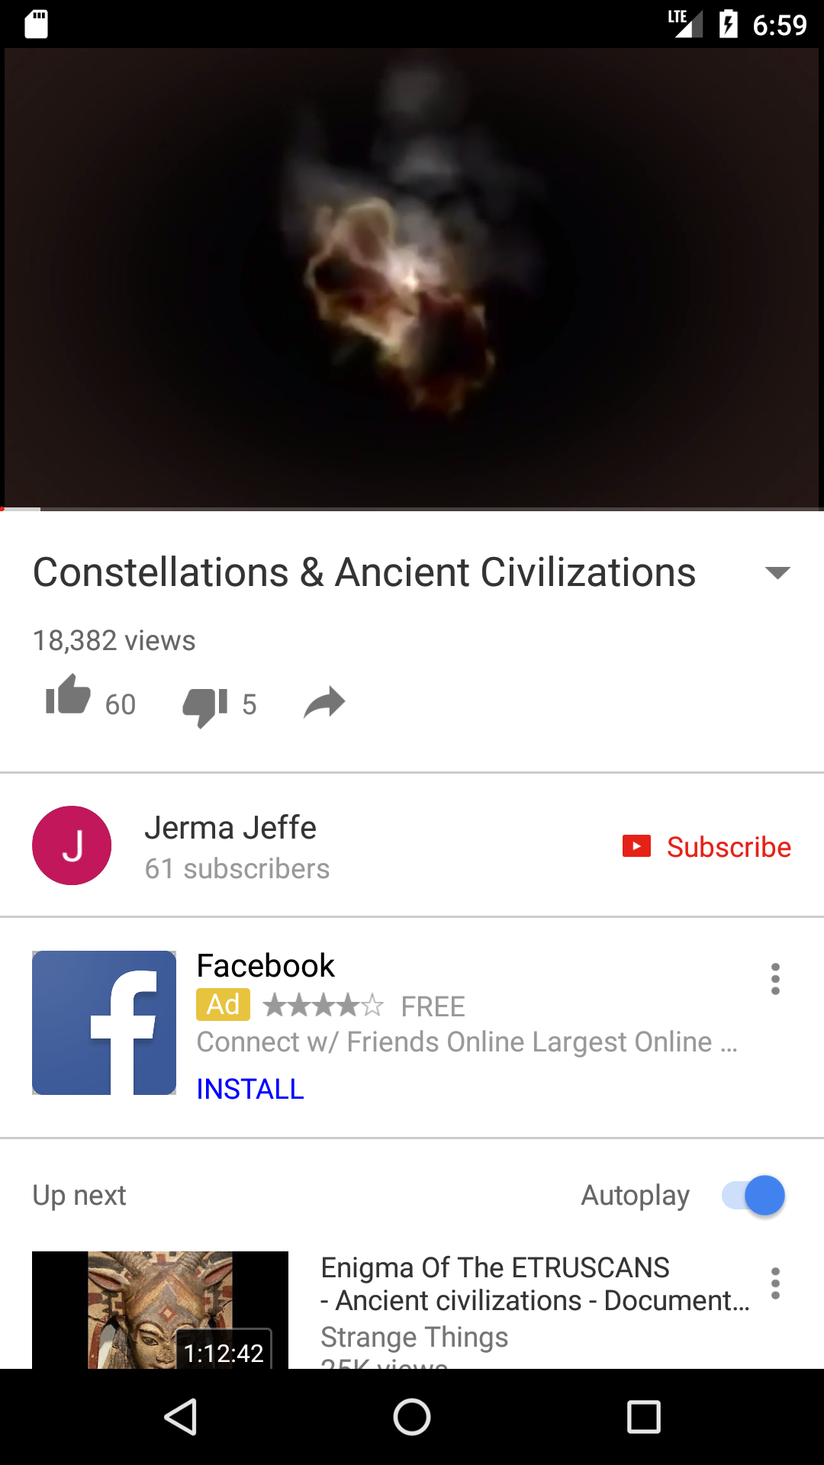
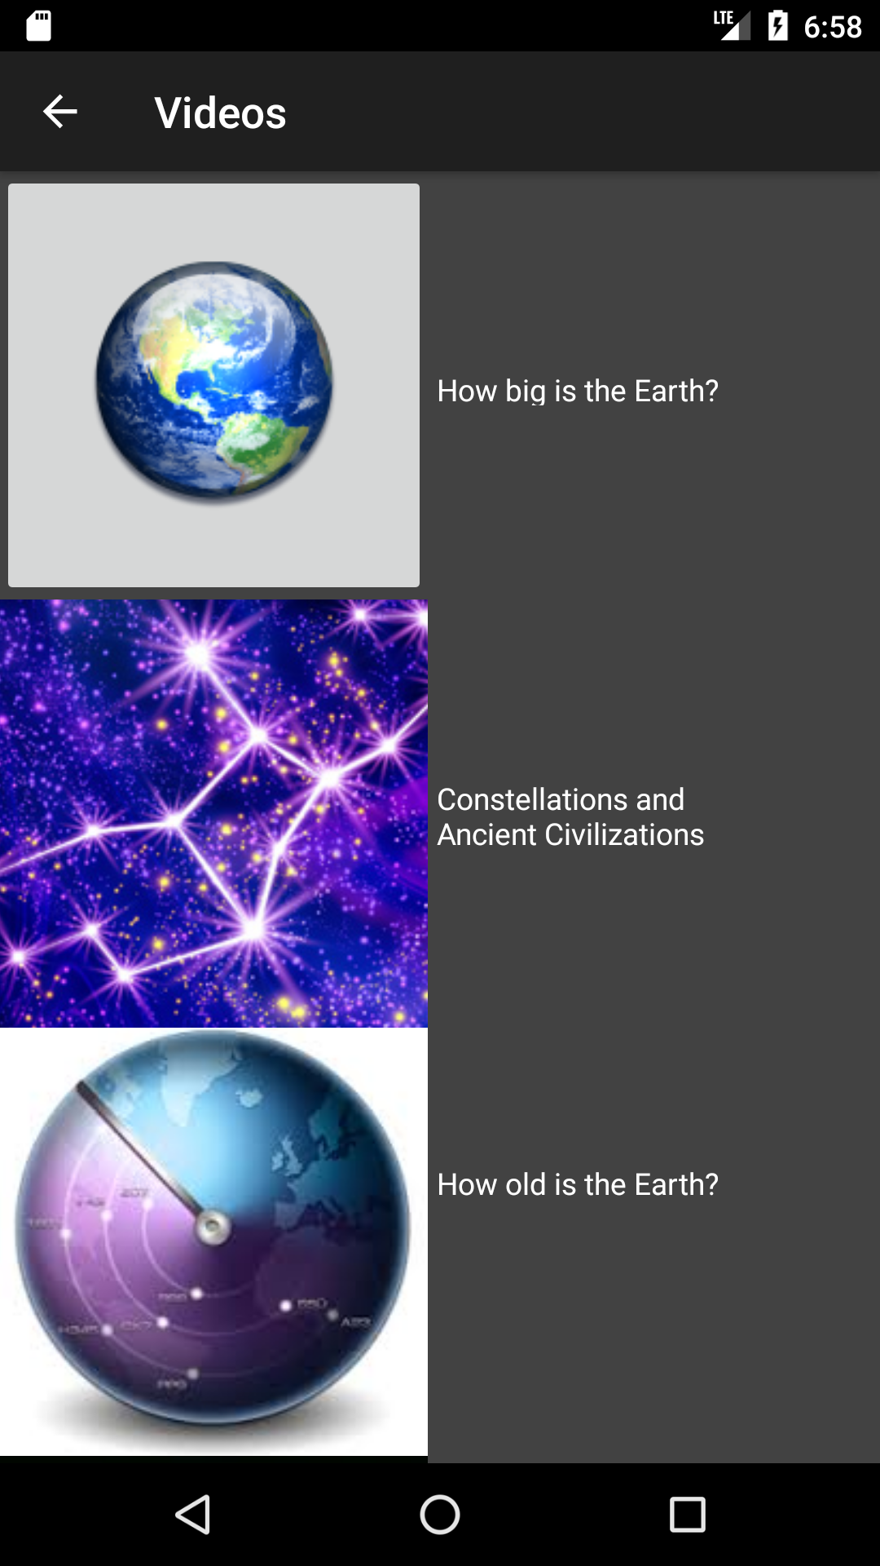

Slide 18
THANKS!
Any questions?

